Slide 1
Updates of Internship project
(23.05.2024)

Slide 2
1
Find error of linear translation stage
TOPICS
Capture image from camera
2
3
Find center coordinates and distance of circle
Experiment
4

Slide 3
1
Find error of linear translation stage
Capture image from camera
2
TOPICS
3
Find center coordinates and distance of circle
Experiment
4
Feedback and Upgrade
5

Slide 4
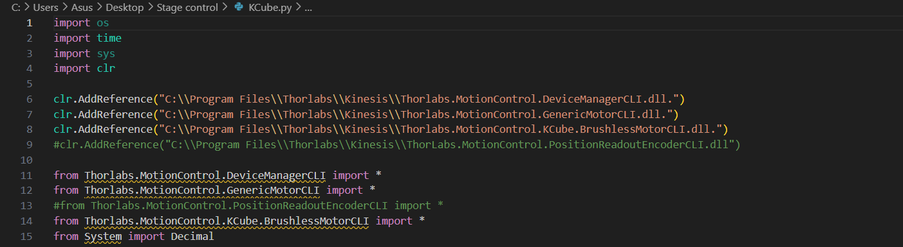
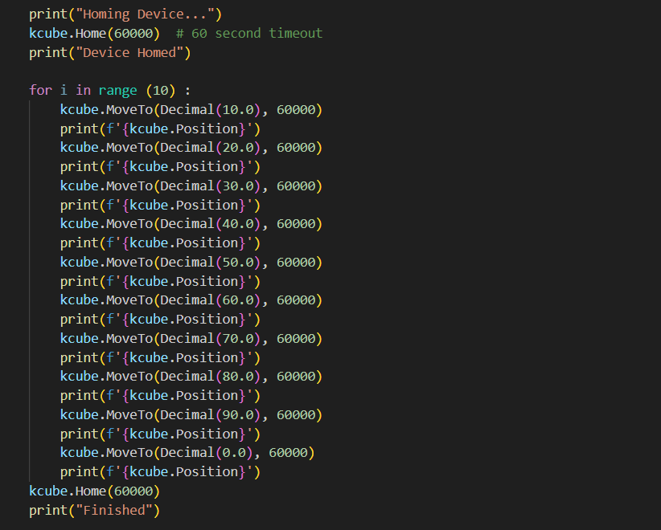
1. Find error of translation stage
Moving translation stage into steps for find error of stage .
Home position can’t change.
Home position is 0.0000 .
1

Slide 5
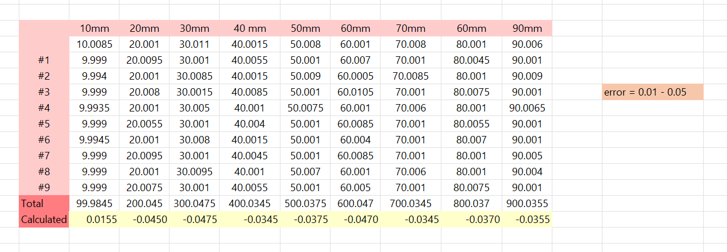
1. Find error of translation stage
Move translation stage from 10.00 mm to 90.00 mm and repeat for 10 times
then find range of error.
Error of translation stage is 0.0100 – 0.0500 .
2

Slide 6

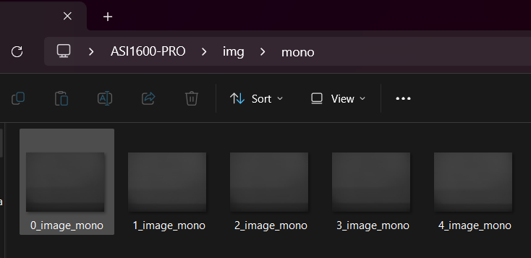
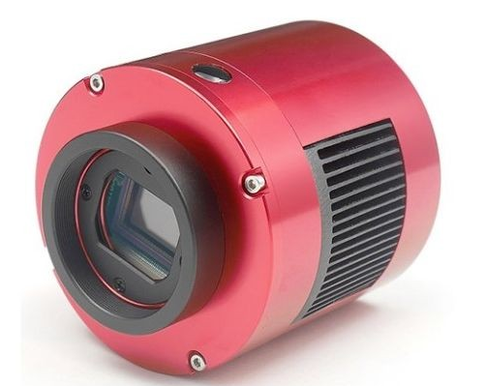
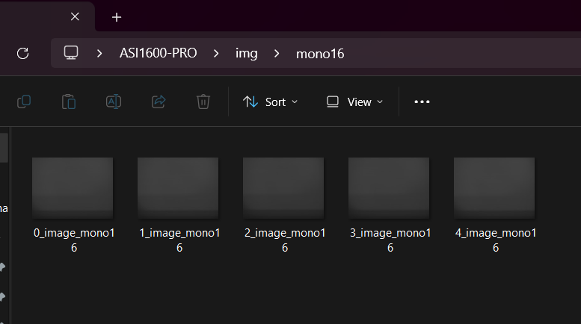
2. Capture image from camera
Try capture some image from ASI1600-PRO Camera and save images into .jpg for MONO8 and .tiff file. For MONO16
https://www.tecnosky.eu/index.php/zwo-asi-1600mm-pro-usb-3-0-cooled-mono.html
3

Slide 7
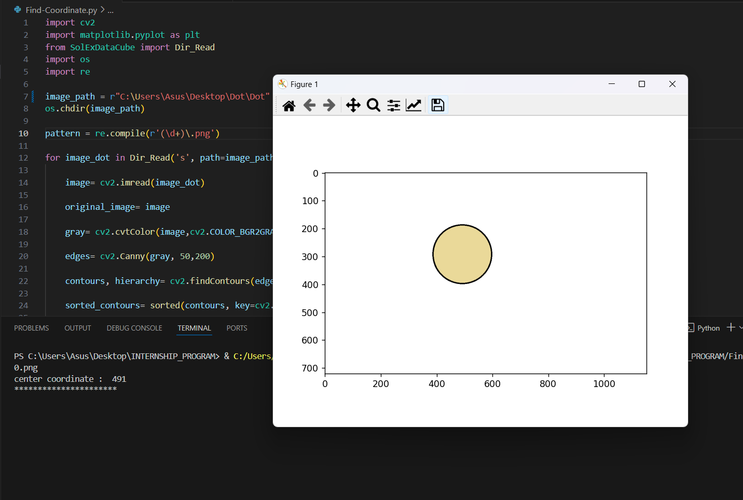
3. Find center coordinates and distance of circle
METHOD 1
Find center coordinates of circle by
Using OpenCV for find edge , contour area and coordinate of center point.
Use Matplotlib for plot circle.
4

Slide 8
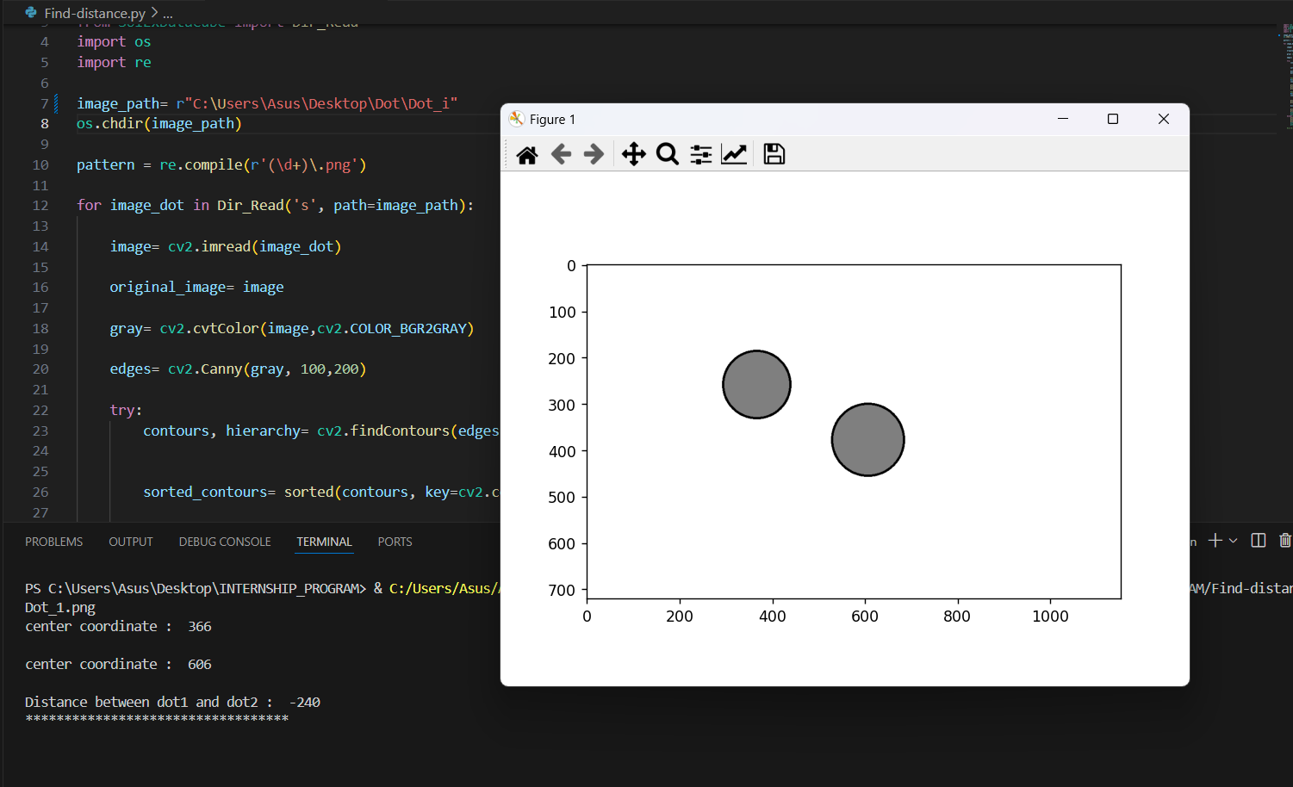
3. Find center coordinates and distance of circle
METHOD 1
Find distance between 2 circle by
1.Find coordinate of center of 2 circles
2.Subtrac coordinate of center of 2 circles
5

Slide 9
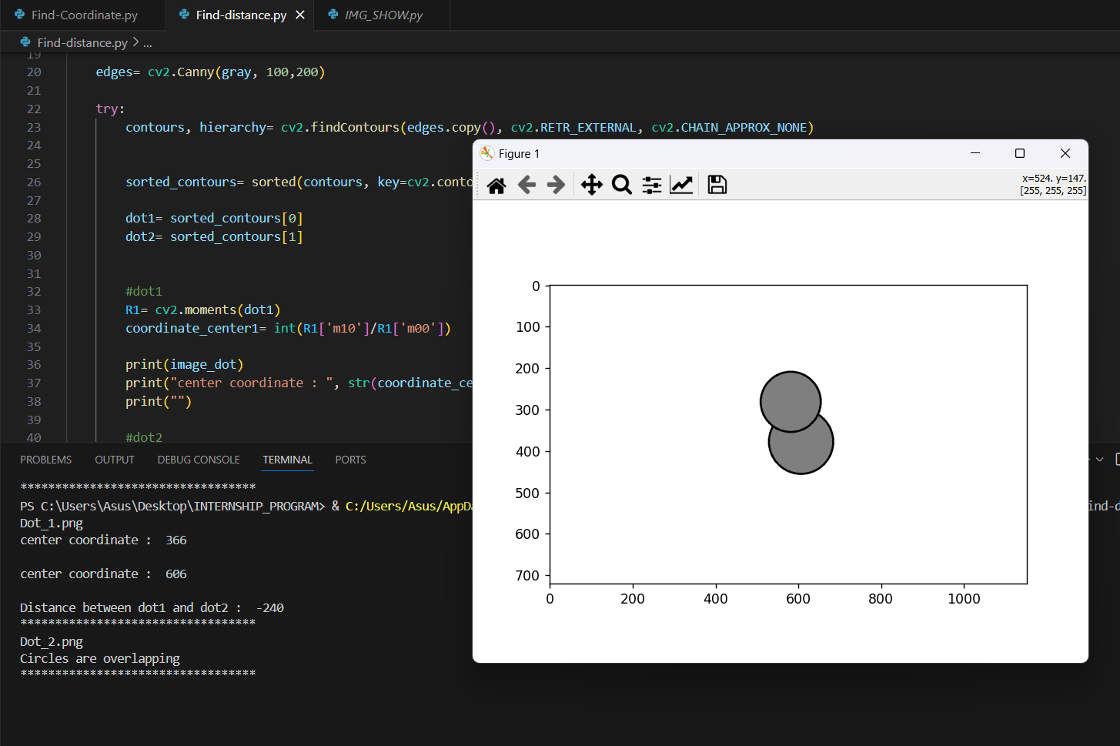
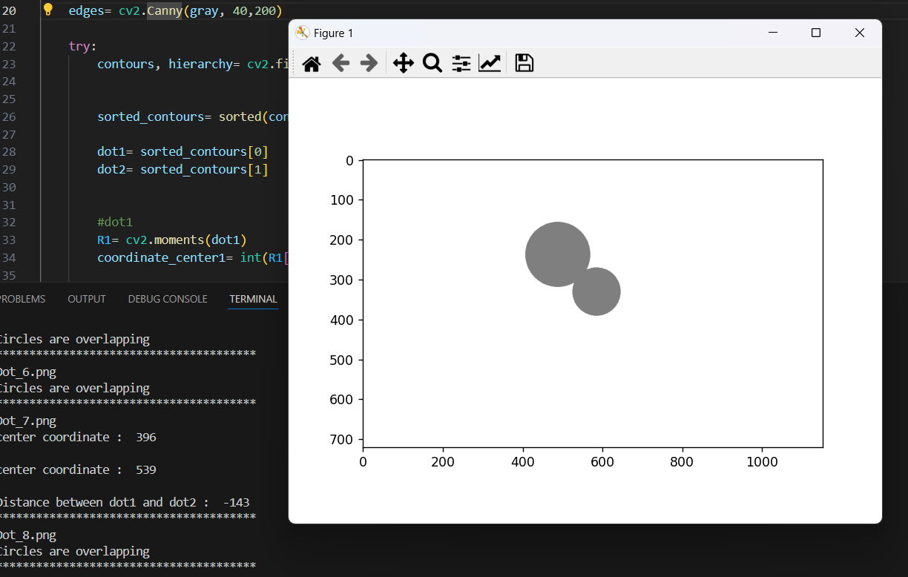
3. Find center coordinates and distance of circle
METHOD 1
Can’t use this condition with image that has 2 circles that are overlapping
6

Slide 10
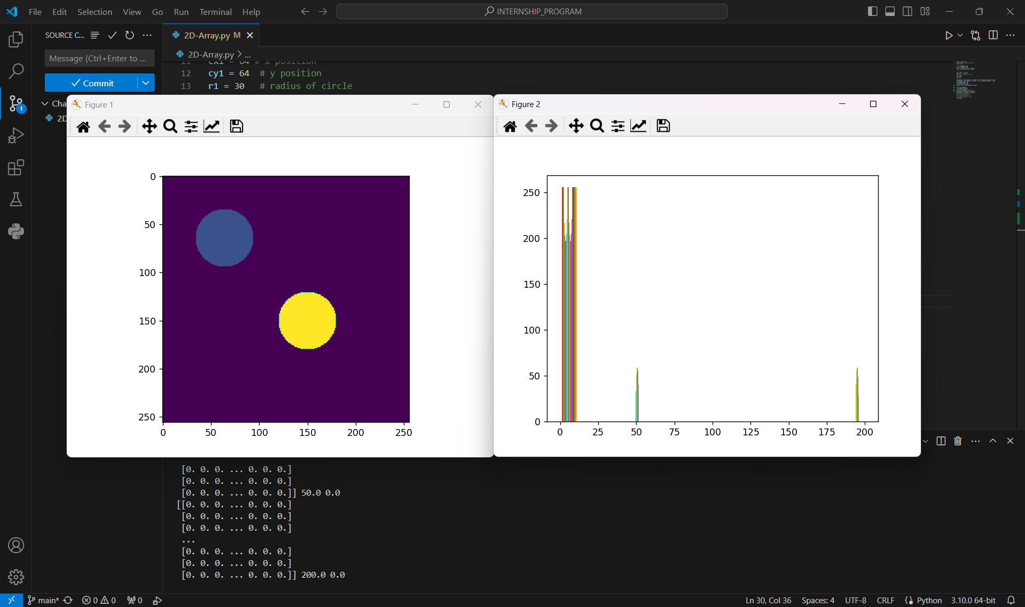
3. Find center coordinates and distance of circle
METHOD 2
Coding program for draw and plot circles from circle formula .
Initialize as 2D array .
Plot histogram for see intensity of circle
7

Slide 11
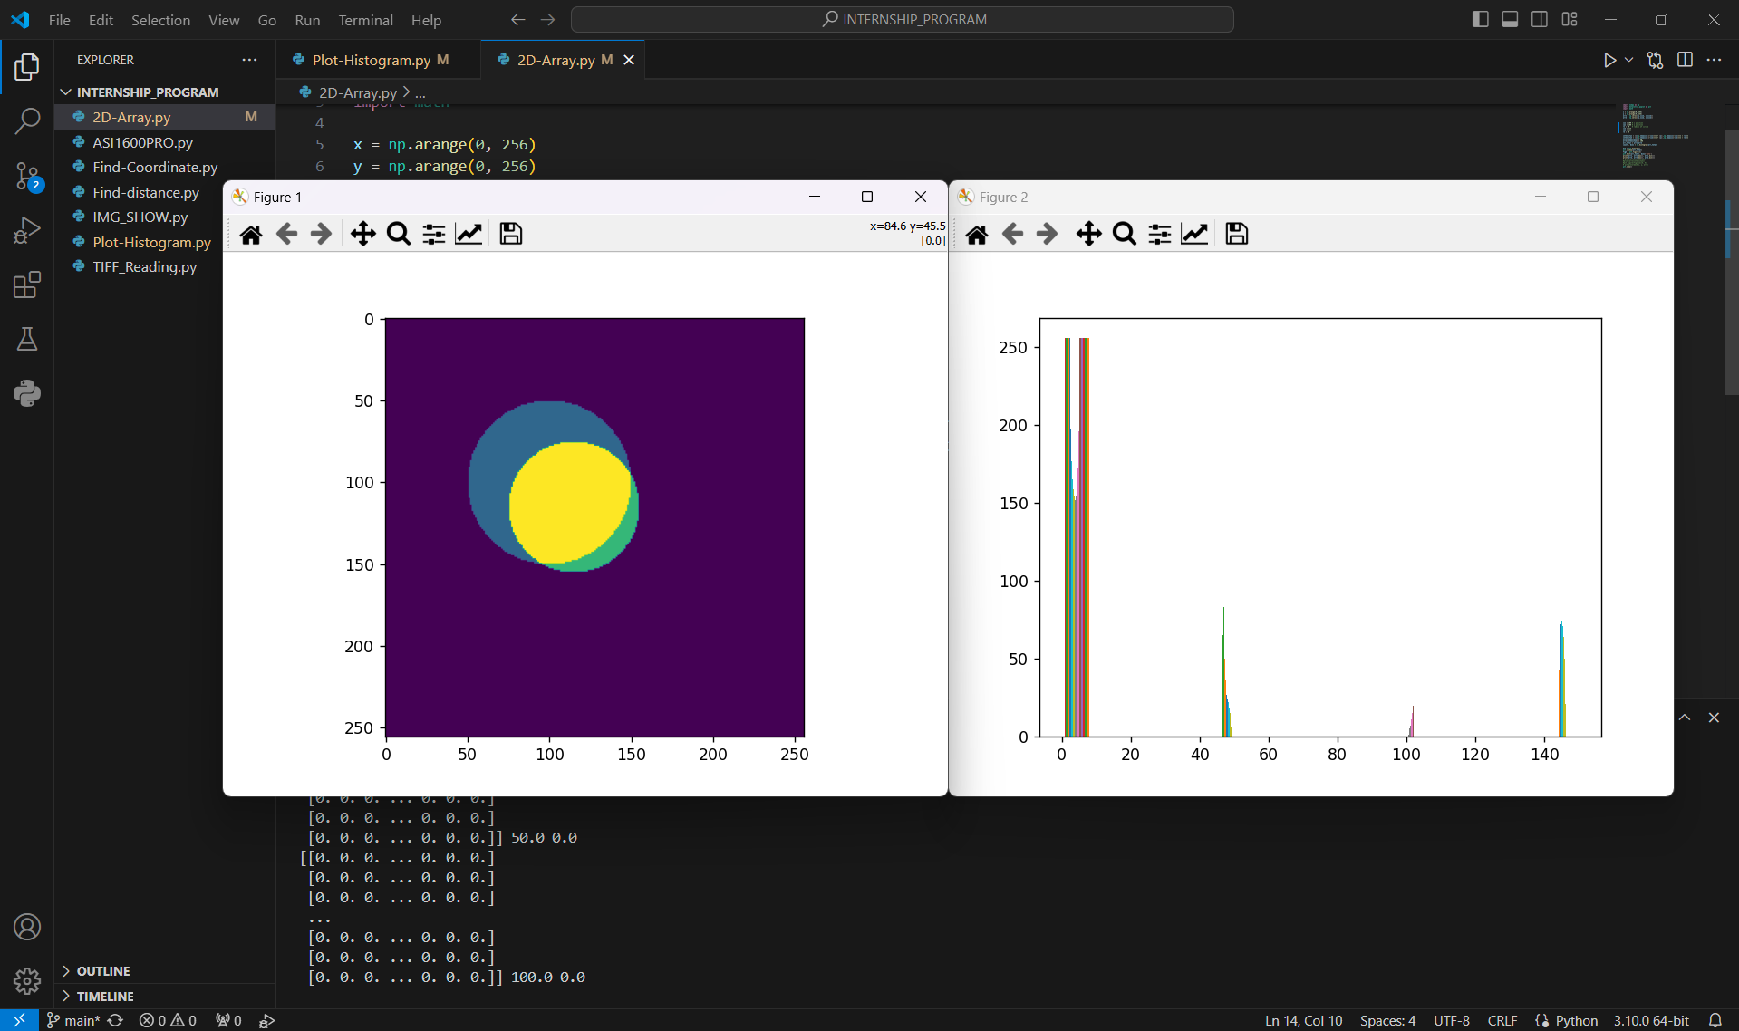
3. Find center coordinates and distance of circle
METHOD 2
This code works for overlapped circle condition .
8

Slide 12
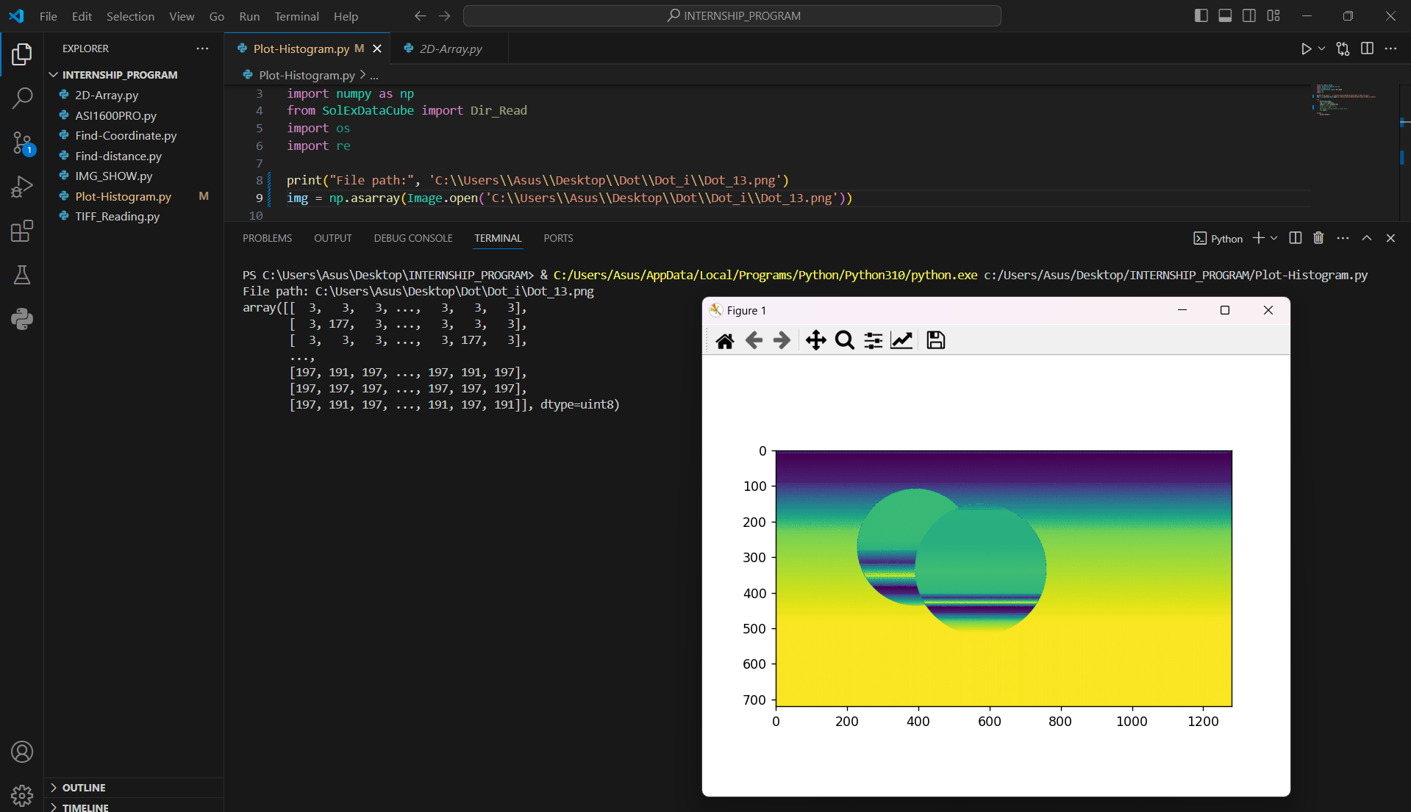
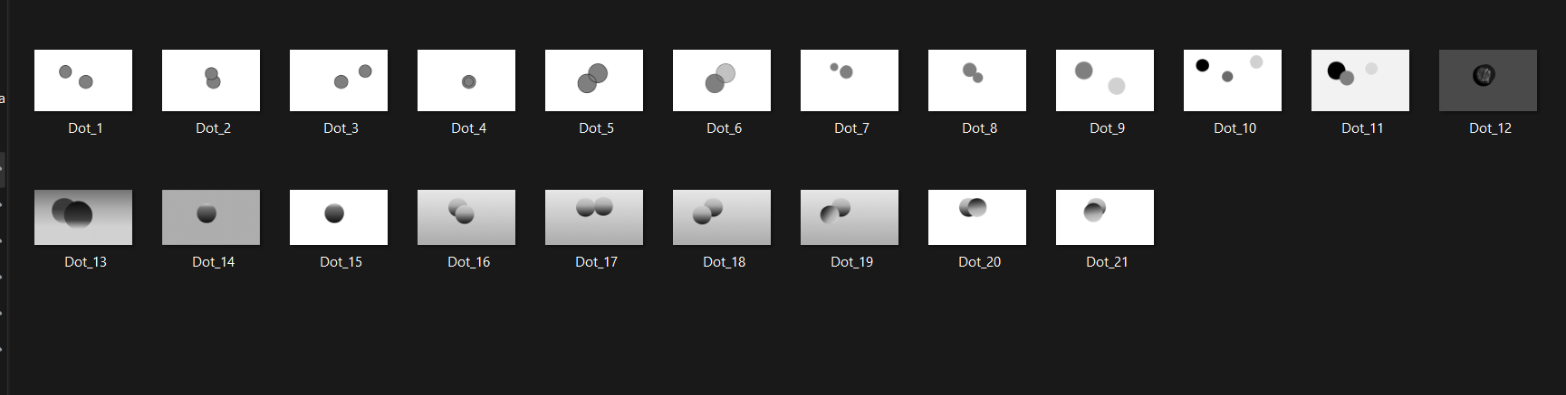
METHOD 2
3. Find center coordinates and distance of circle
Plot histogram from non-uniform image .
9

Slide 13
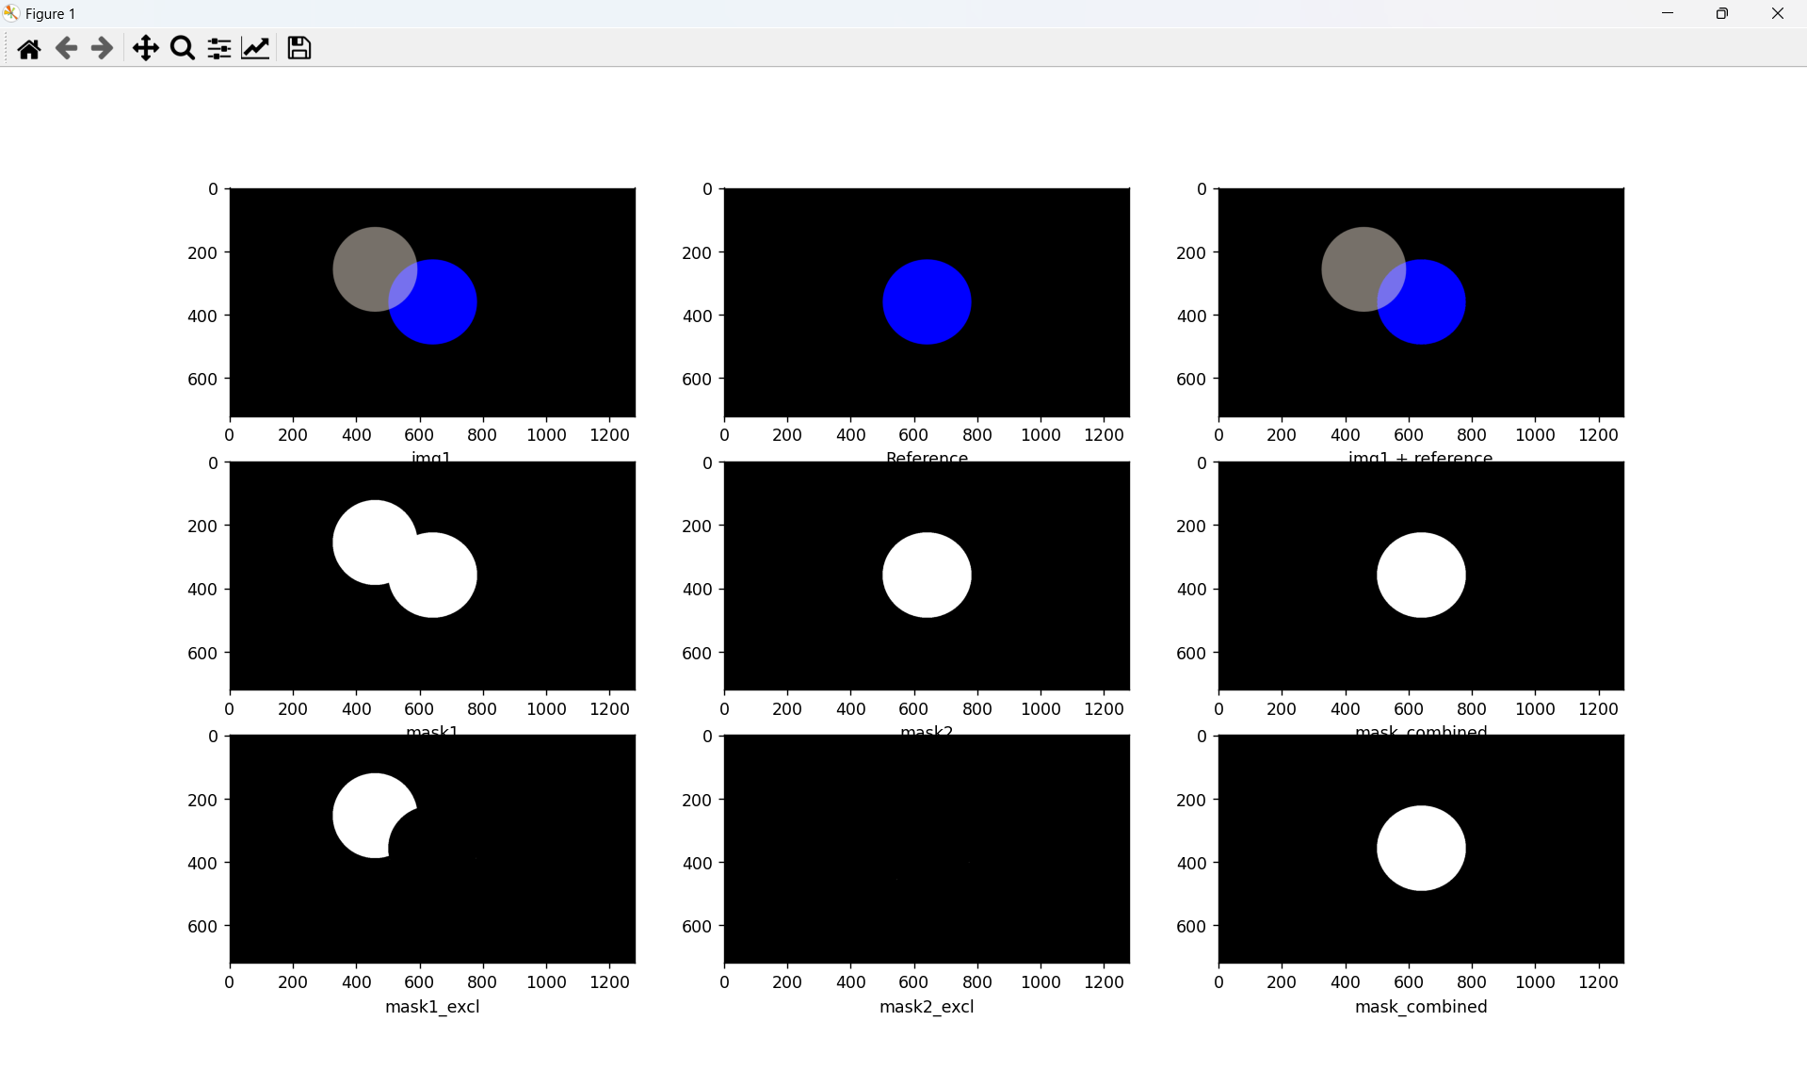
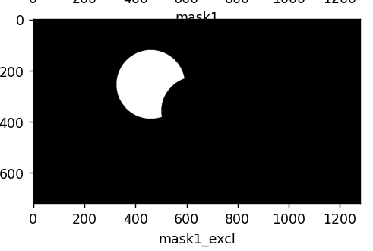
METHOD 3
3. Find center coordinates and distance of circle
AND
XOR
Main idea of this concept is
Use bitwise operation (AND , XOR) for find contour area that not overlapping. Then draw bounding box around the area then find height and width then calculate center of the area from height and width. Then find distance between 2 center point.
10

Slide 14
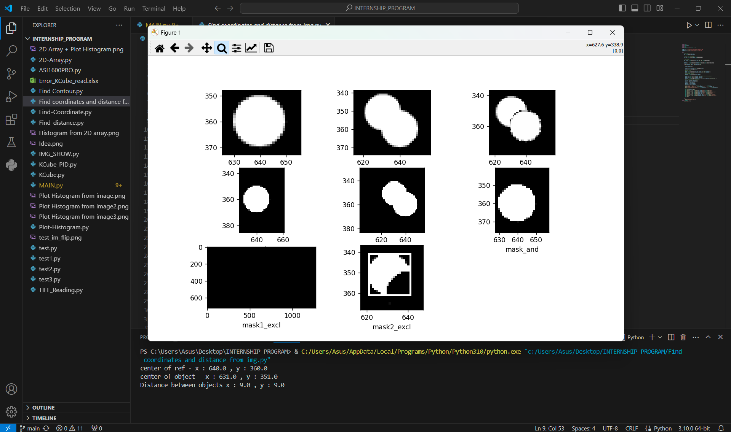
METHOD 3
3. Find center coordinates and distance of circle
11

Slide 15
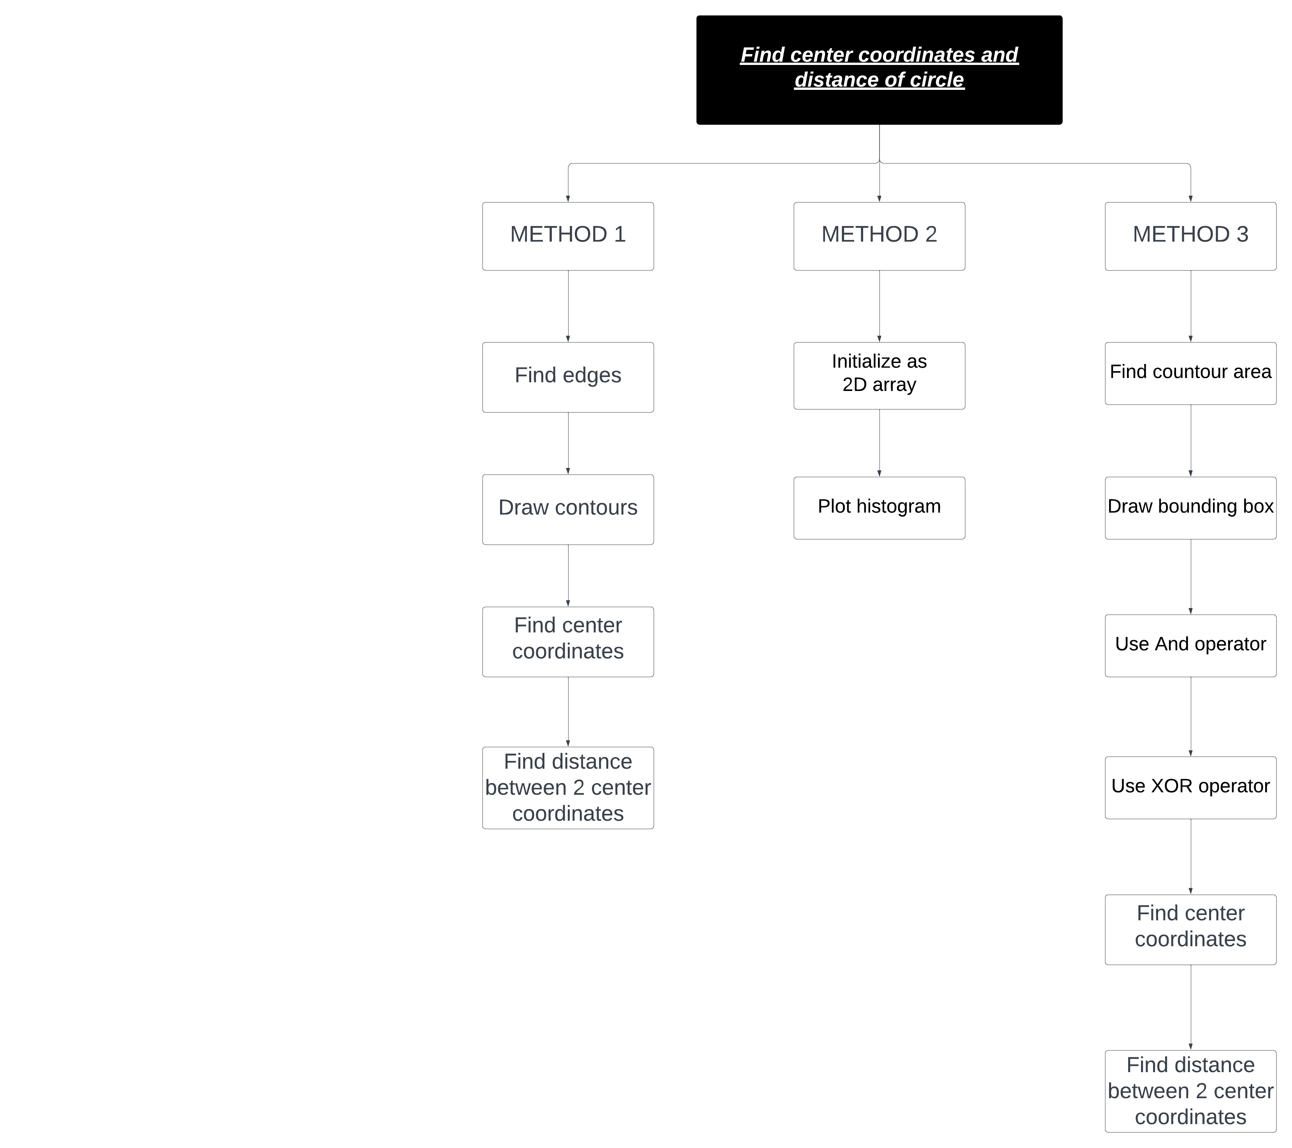
OVERVIEW MAP
12

Slide 16
METHODS | ADVENTAGES | DISVENTAGES
METHOD 1 | Easy for operate | Can’t use this method with overlapped images
METHOD 2 | Can use this method with overlapped images | Can’t find distance between 2 images.
METHOD 3 | Can use this method with overlapped images | -
13

Slide 17
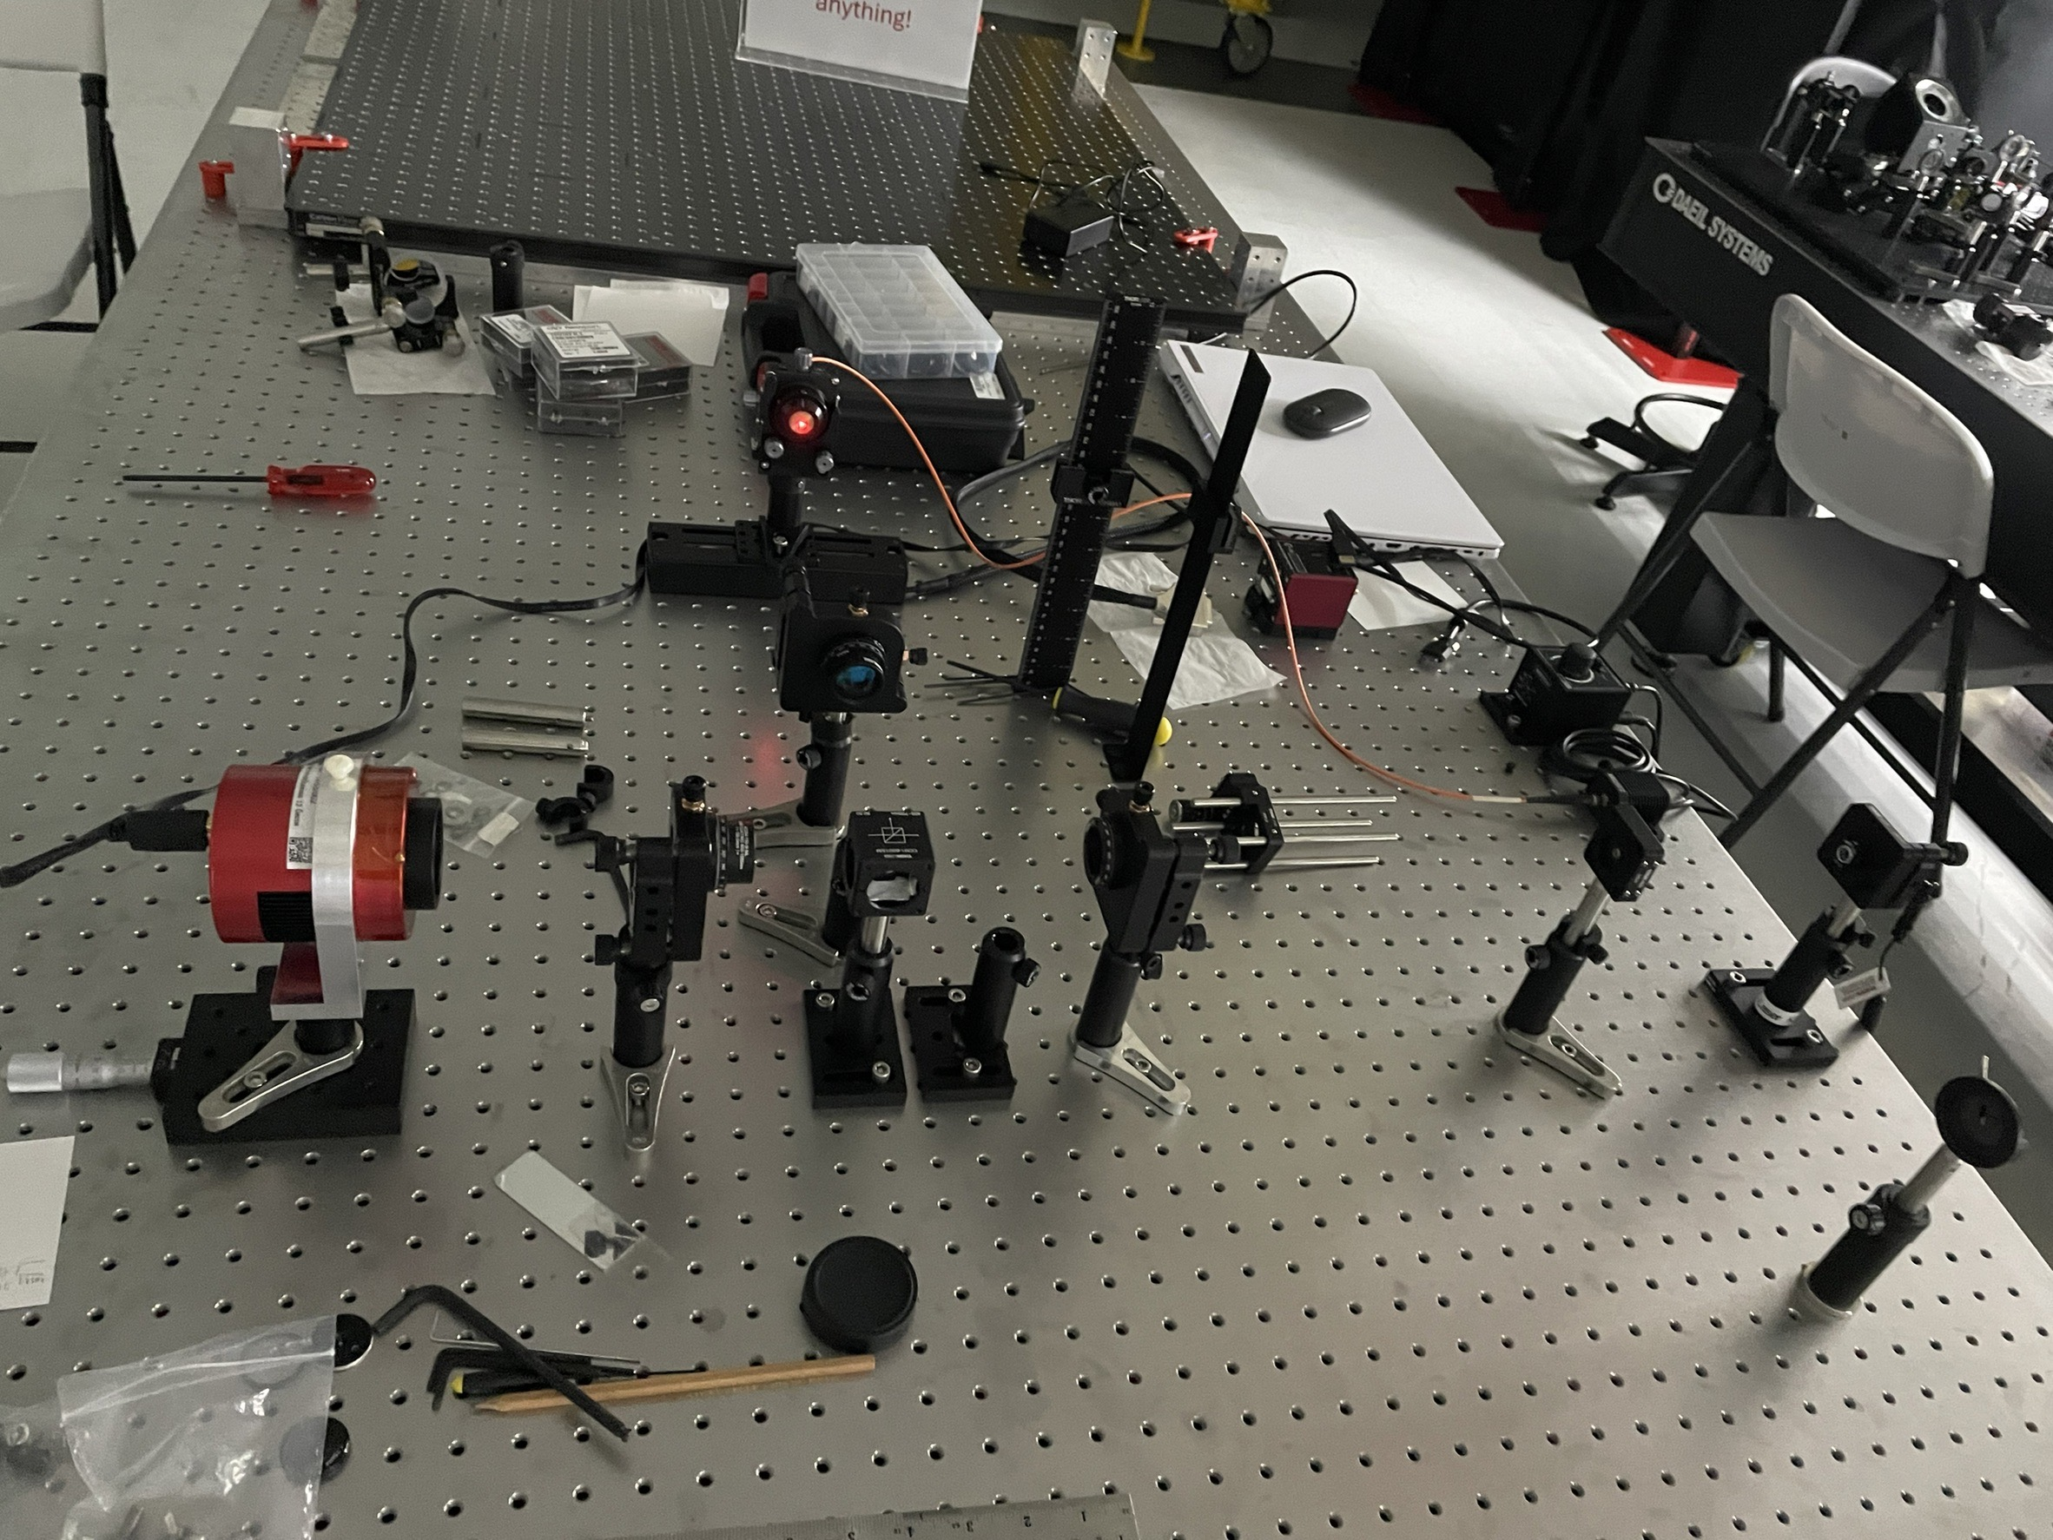
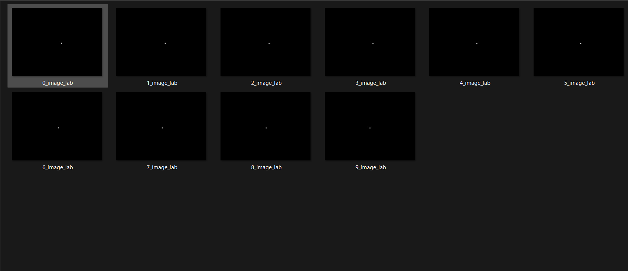
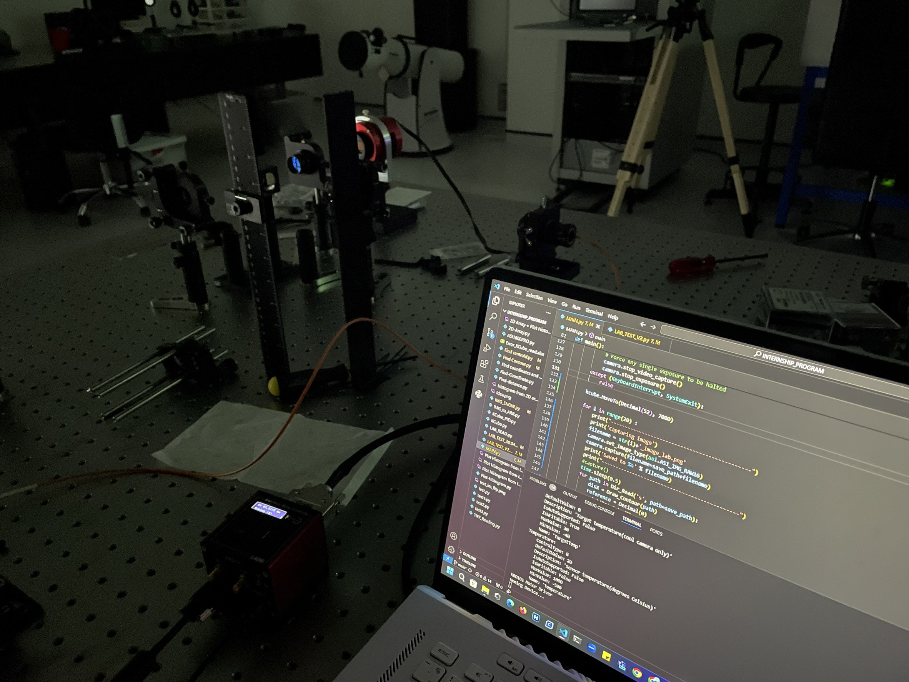
4. EXPERIMENT
Test code in lab for collect real data and find error of process of code when run in real situation.
14

Slide 18
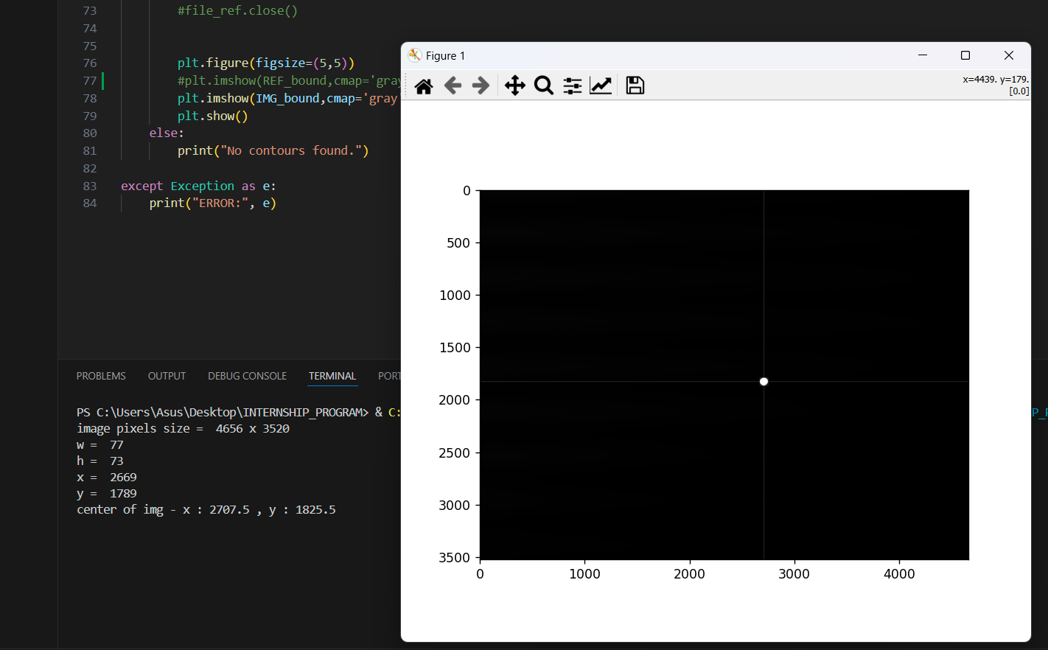
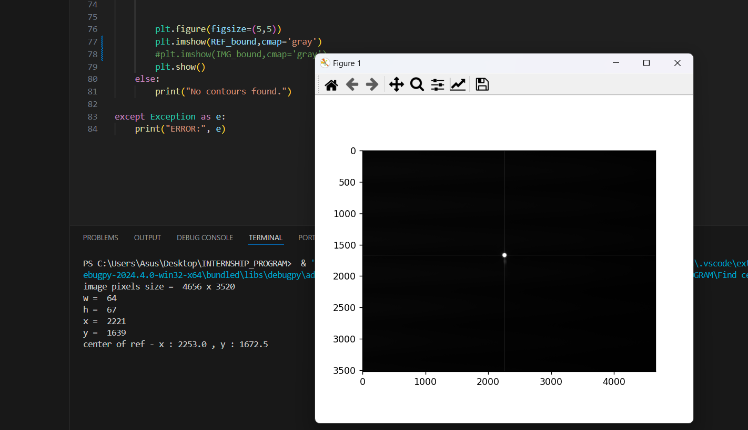
4. EXPERIMENT
Problem and solution 1
Have only one light source
so it can’t see 2 dot in one image at the same time.
Find centroid and position of dot both in reference image and collected image.
Compare position of current image with reference image.
15

Slide 19
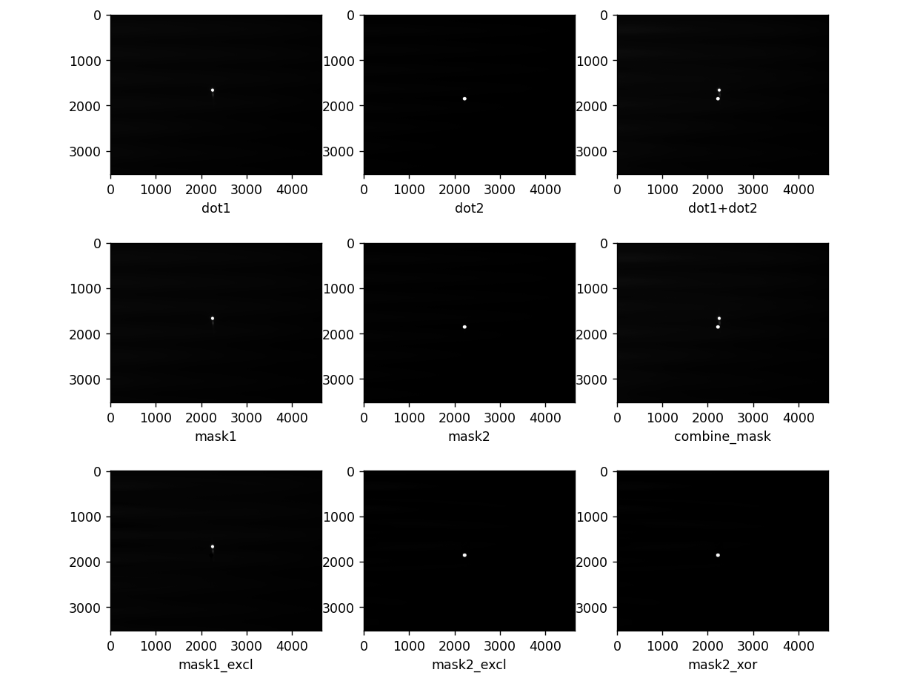
4. EXPERIMENT
16

Slide 20
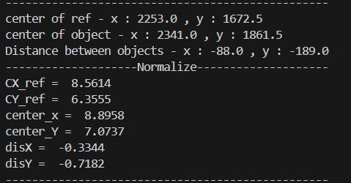
4. EXPERIMENT
Normalized data from pixel to mm.
17

Slide 21
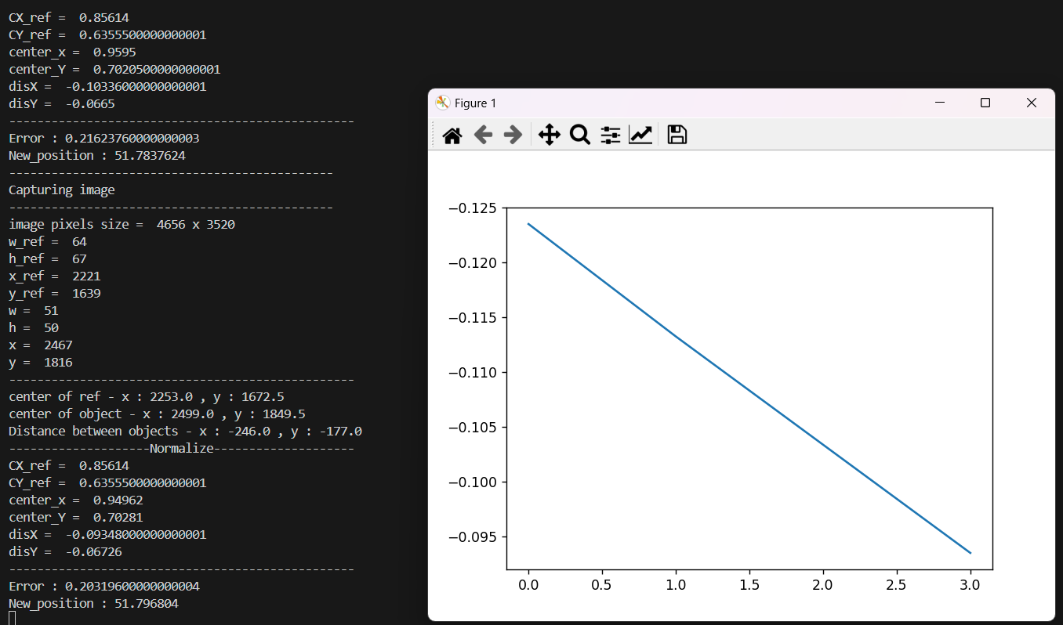
4. EXPERIMENT
Try read collected images and tuning pid then plot graph .
18

Slide 22
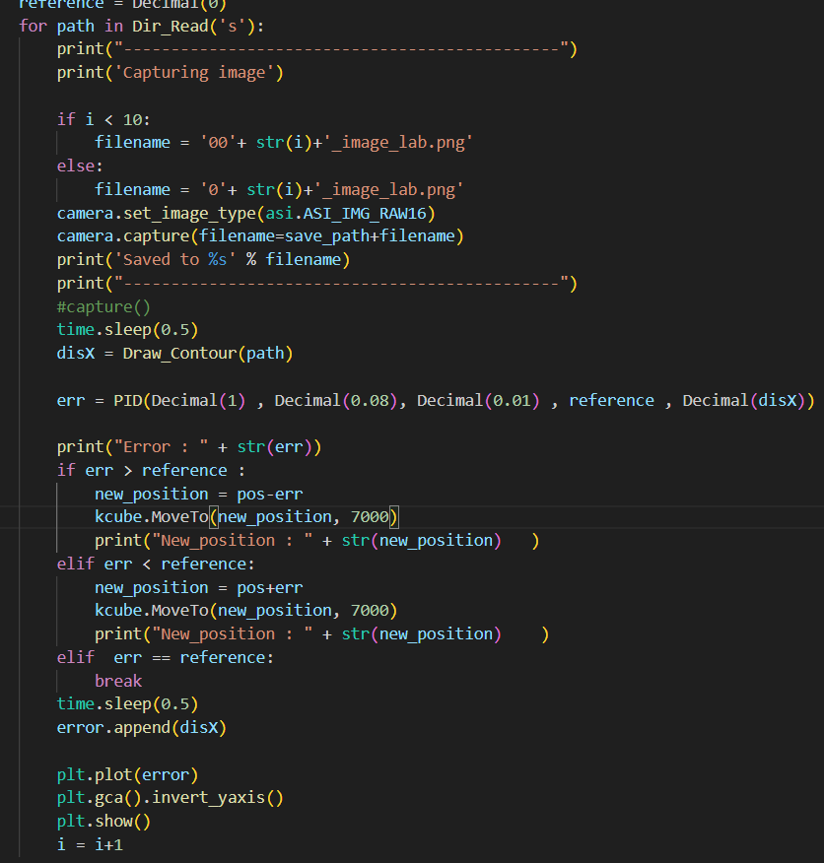
4. EXPERIMENT
Problem and solution 2
Program doesn’t read current images that had capture . It’s read and overwrite old images in directory instead .
Coding new program that has infinity loop and can read images from current images .
19

Slide 23
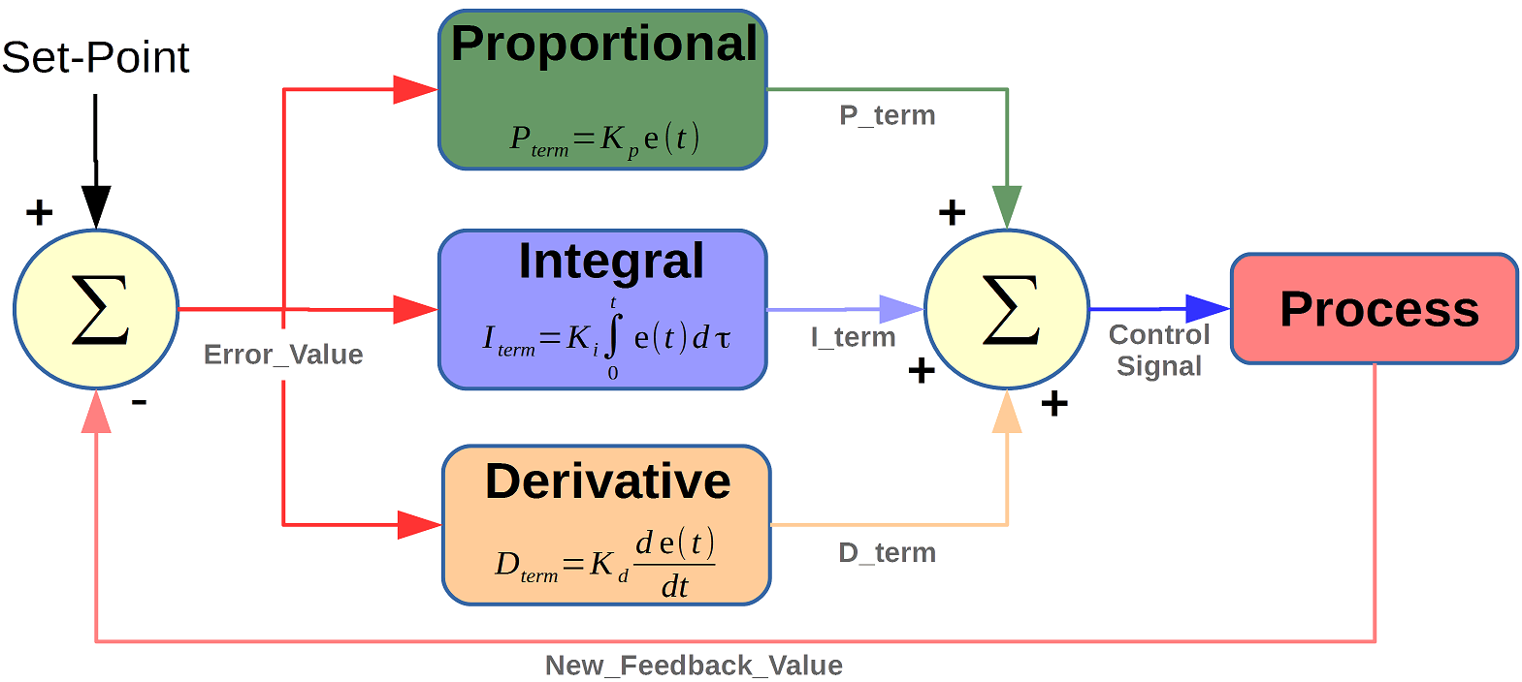
PID CONTROLLER
Stands for “Proportional, Integral, Derivative” .
It is closed-loop feedback control .
instrument used by control engineers to regulate temperature, flow, pressure, speed, and other process variables in industrial control systems.
https://microcontrollerslab.com/pid-controller-implementation-using-arduino/
20

Slide 24
PID CONTROLLER
P : Proportional
tuning -> correcting a target proportional to the difference
based on the current error ( setpoint - measured output of the system )
I : Integral
tuning -> cumulating the error result from the “P” action to increase the correction factor
Increase -> increases the contribution of the accumulated error over time to the control signal
D : Derivative
tuning -> minimize overshoot by slowing the correction factor
reduce the rate of change of the error
helps improve the stability and responsiveness of the control loop
21

Slide 25
PID CONTROLLER
P Controller
Use only error term to affect the output
simply multiply e(t) * Kp
provides a linear relationship between the error of a system and the controller output of the system
I Controller
responding to accumulated past error
much slower in their response time than P-only controllers
used when measured variables need to remain within a very narrow range and require fine-tuning control
22

Slide 26
PID CONTROLLER
D Controller
do not guide the system to a steady state
must be coupled with P, I or PI controllers
measure only the change in error
23

Slide 27
PID CONTROLLER
PI Controller
a combination of Proportional controller action and Integral controller action
correlates the controller output to the error and the integral of the error.
provides a faster response time than I-only control
Eliminates steady state error
Application - Cruise control, industrial process
24

Slide 28
PID CONTROLLER
PD Controller
combination of feedforward and feedback control
contains - proportional control’s damping of the fluctuation
- derivative control’s prediction of process error output
Improves transient response, reduces overshoot
Application - Robotics, motion control
25

Slide 29
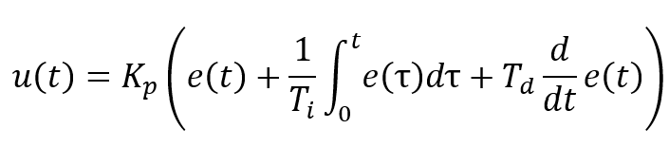
PID CONTROLLER
PID Controller
a combination of all three types of control methods
most commonly used
balances steady state and transient response
Application - Automation system
https://www.crystalinstruments.com/blog/2020/8/23/pid-control-theory
26

Slide 30
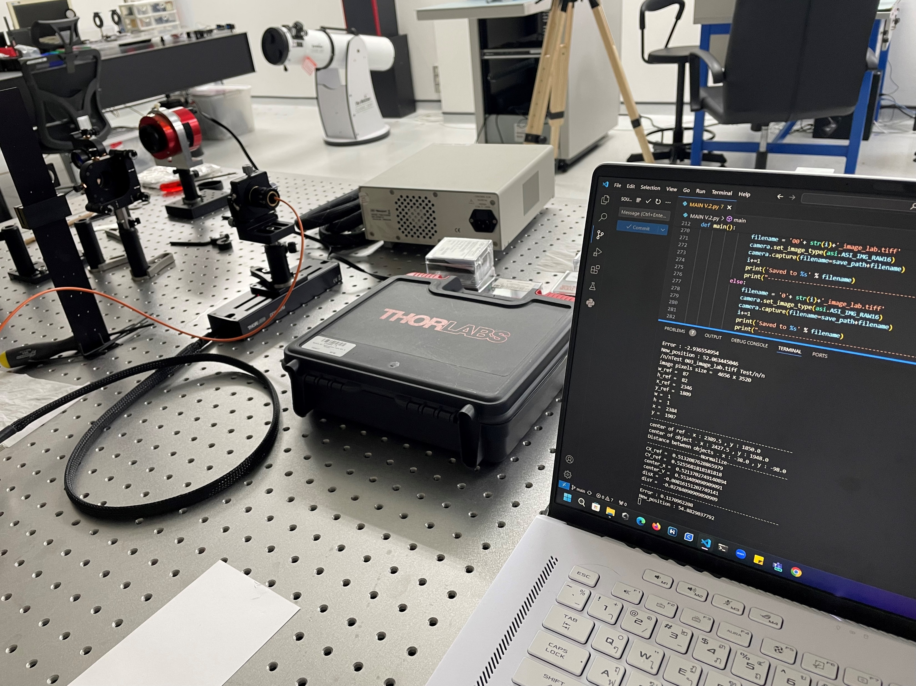
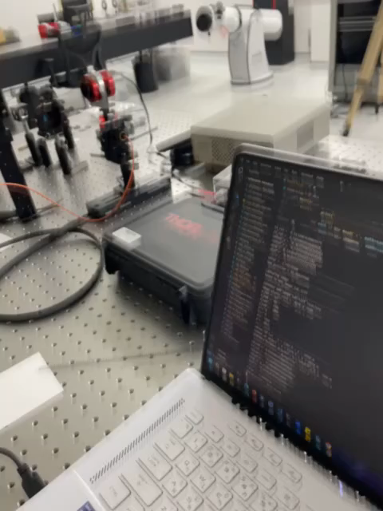
4. EXPERIMENT
Current : Trying tuning PID value .
27

Slide 31
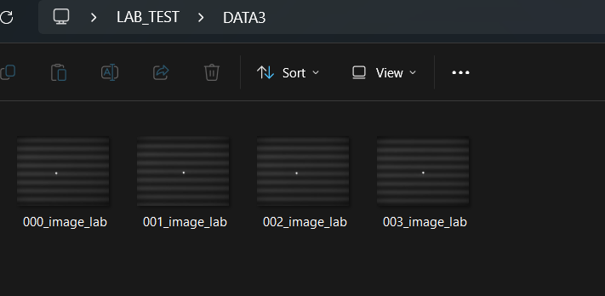
4. EXPERIMENT
RESULT
Program work well.
Can collect images and tuning PID.
The range of acceptable position is 52.0 - 52.05
28

Slide 32
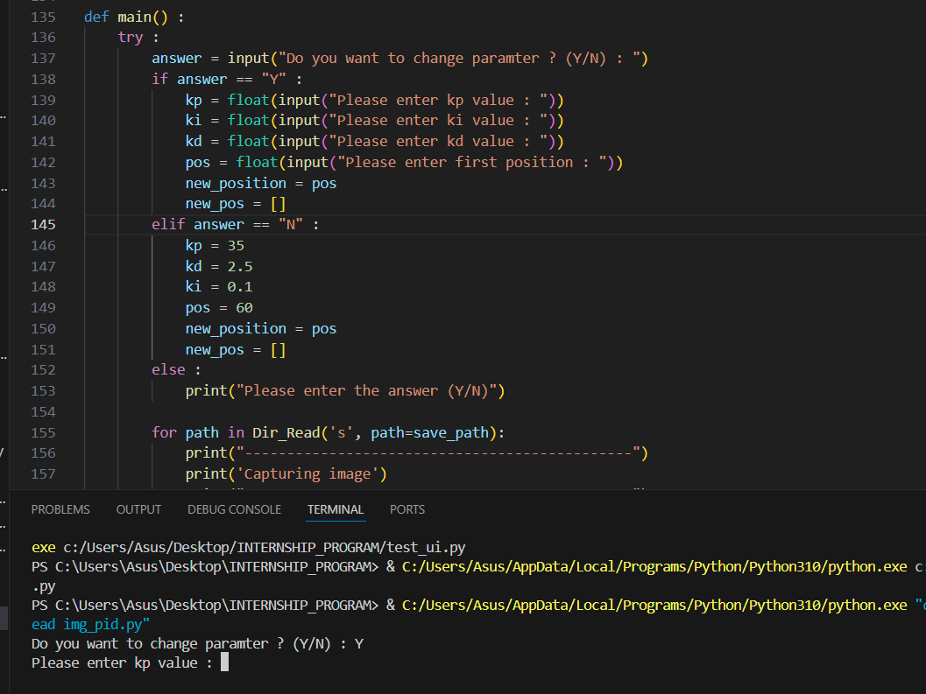
Additional
Add input command for another user .
29

Slide 33
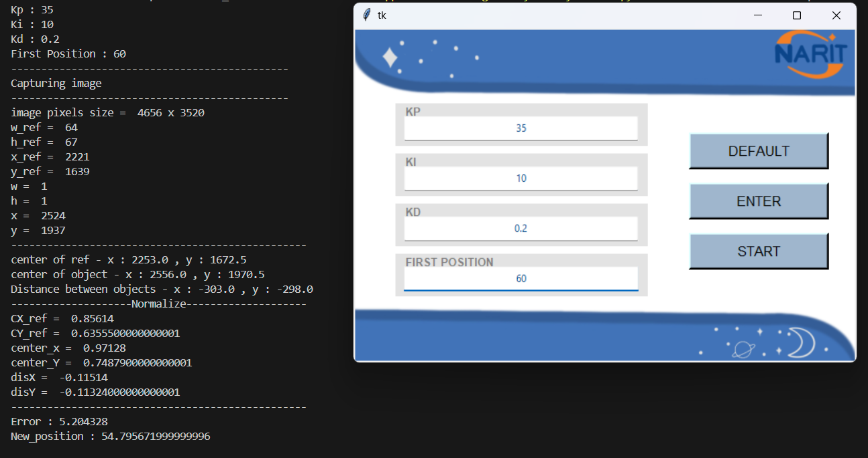
Additional
Add ui window for another user .
30

Slide 34
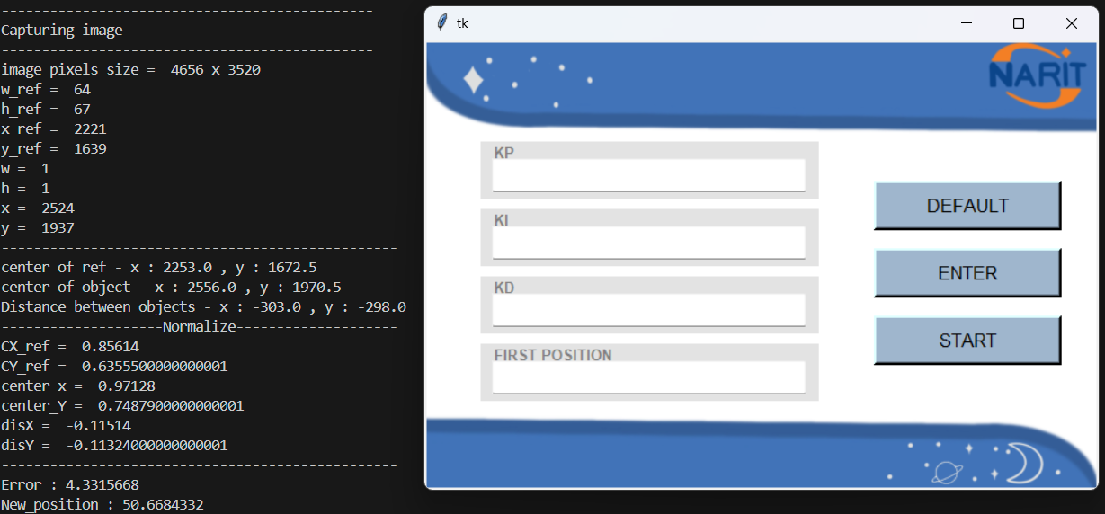
Additional
Have 2 options .
Option 1 : Enter values with default values.
Click “DEFAULT” button then program will start immediately .
31

Slide 35
Additional
Option 2 : Enter values with other values.
Enter each value in each entry box the click “ENTER” button then click “START” for starting program.
32

Slide 36
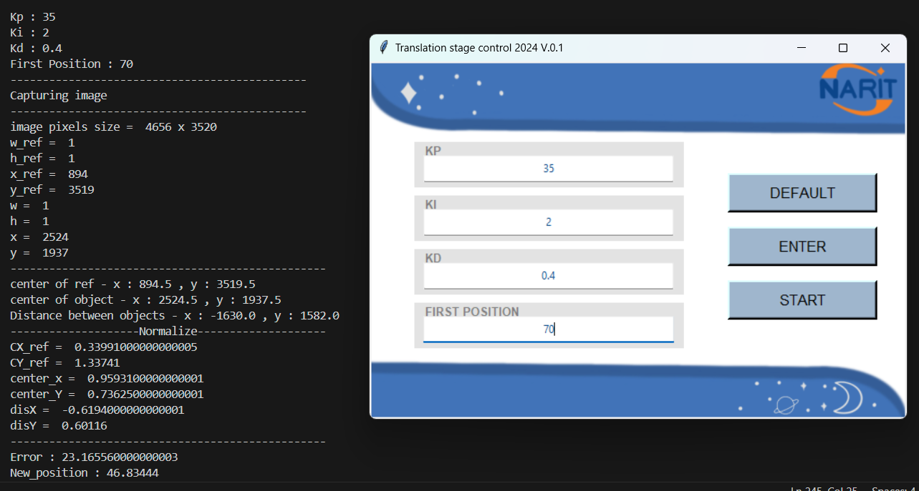
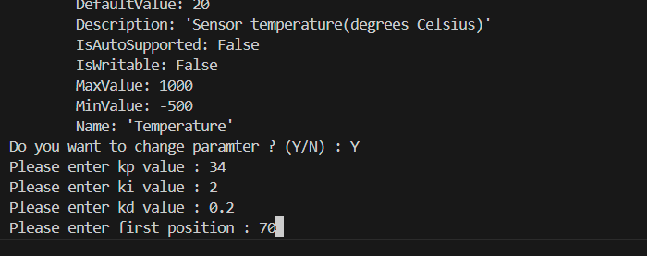
Both UI version and input command in terminal version work successfully.
Can control translation stage with PID closed loop control and collect images.
UI Version
Command line Version
33

Slide 37
Collected feedback from user (researcher)
Add the title of application
Display properly dynamic range of PID parameters
Create Stop and Home button
Initialize the PID parameters in entry boxes
Short describe for effect of each PID parameters
34

Slide 38
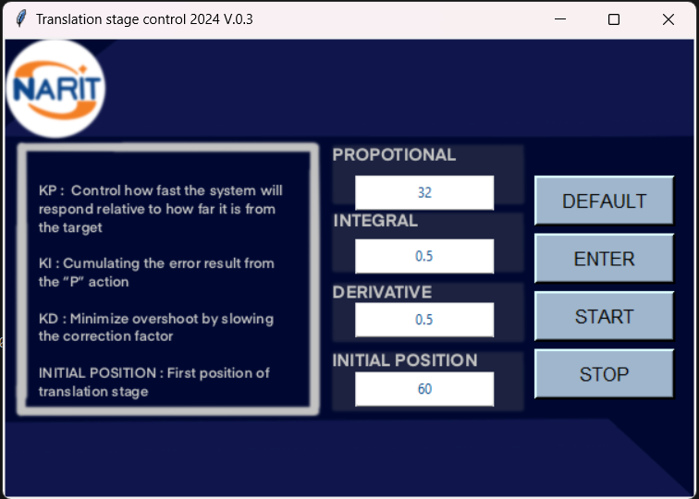
New Version of application
Title of application
Initialized (Default)
PID parameters
Short description about PID parameters
Add Home button
Add stop button
35

Slide 39
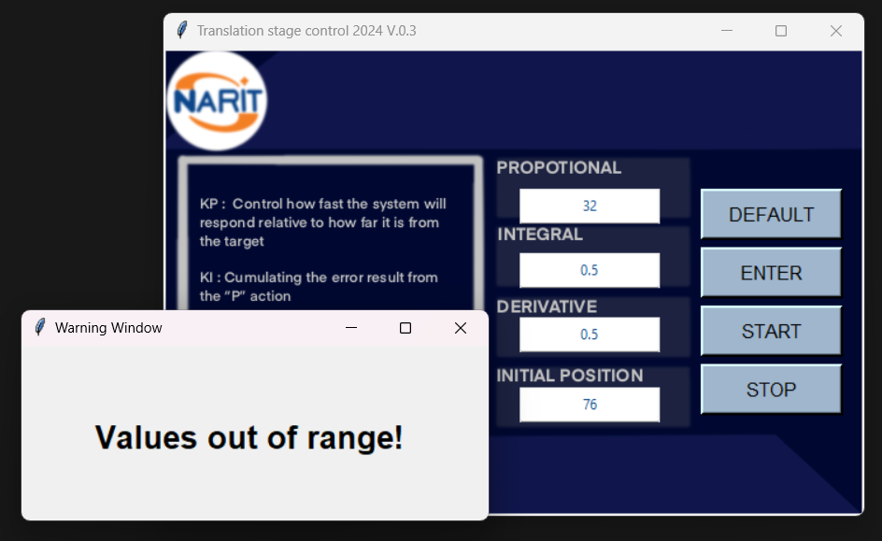
Add “Warning Window” for warning when put some values that out of range.
36

